Slide 1
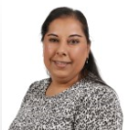
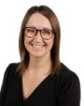

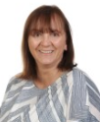
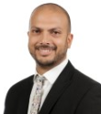
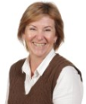
Safeguarding Team
Designated safeguarding lead (DSL): Pal Chahal
Deputy DSL: Elise Waldron
Deputy DSL: Catherine Medhurst
Deputy DSL: Joy Williams
Deputy DSL: Omar Qureshi
Deputy DSL: Debbie Hunt
Notes:
[In advance, edit this slide to include details of your school’s safeguarding team, as set out on the slide. If anyone works part-time, you might want to include what days they work as well.]
Explain that if staff see things like the signs we saw on the previous slide, they need to report it to your school’s safeguarding team
Your safeguarding team has particular responsibilities for safeguarding, beyond the responsibilities that all staff have
Explain that the people on the slide make up your school’s safeguarding team
Briefly talk through each person and their responsibilities

